Slide 1

ECE 554 Just Dance Architectural Review

Slide 2
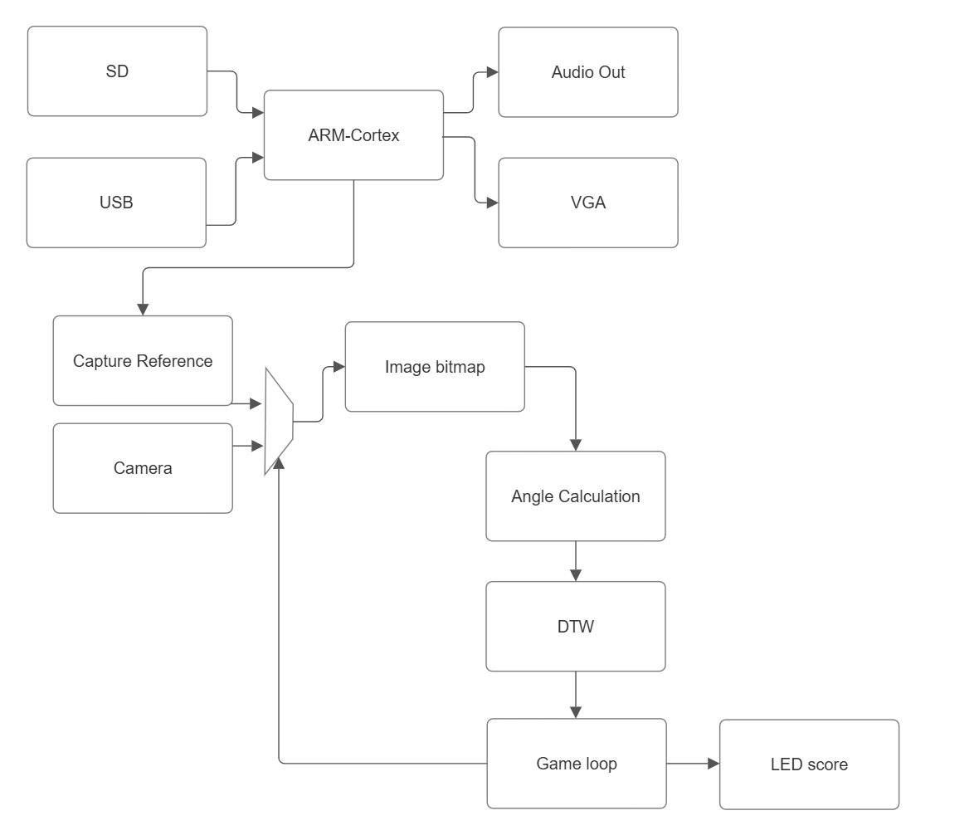
High Level Block Diagram

Slide 3
External Connections and Peripherals
Linux Image (HPS)
Connection made to DE1-SoC via Micro SD Card
Needed to work with HPS peripherals
Linux CLI machine (HPS)
Connection made to DE1-SoC via USB to mini-usb b port (UART to USB)
This will serve as our interface for setting up our USB 2.0 data transfer protocols
Machine that originally has MP4 file (HPS)
Connection made to DE1-SoC via USB to USB port
This will be how the MP4 data is transferred over to the board for preprocessing
Camera (FPGA)
Connection made to DE1-SoC via GPIO 1 ports
This will be how we capture the user movement data for processing
Monitor (FPGA)
Connection made to DE1-SoC via VGA port
This will be how we display to the user the video portion of the MP4 data for reference
Speaker (FPGA)
Connection made to DE1-SoC via Line Out and Line In (green and blue)
This is how we output the sound data of the MP4 file
Push Buttons (FPGA)
Will serve start, restart, and stop functionalities.
7-Segment Display (FPGA)
Will display the game score
Notes:
Reach out to Shantanu if there any concerns with this slide

Slide 4
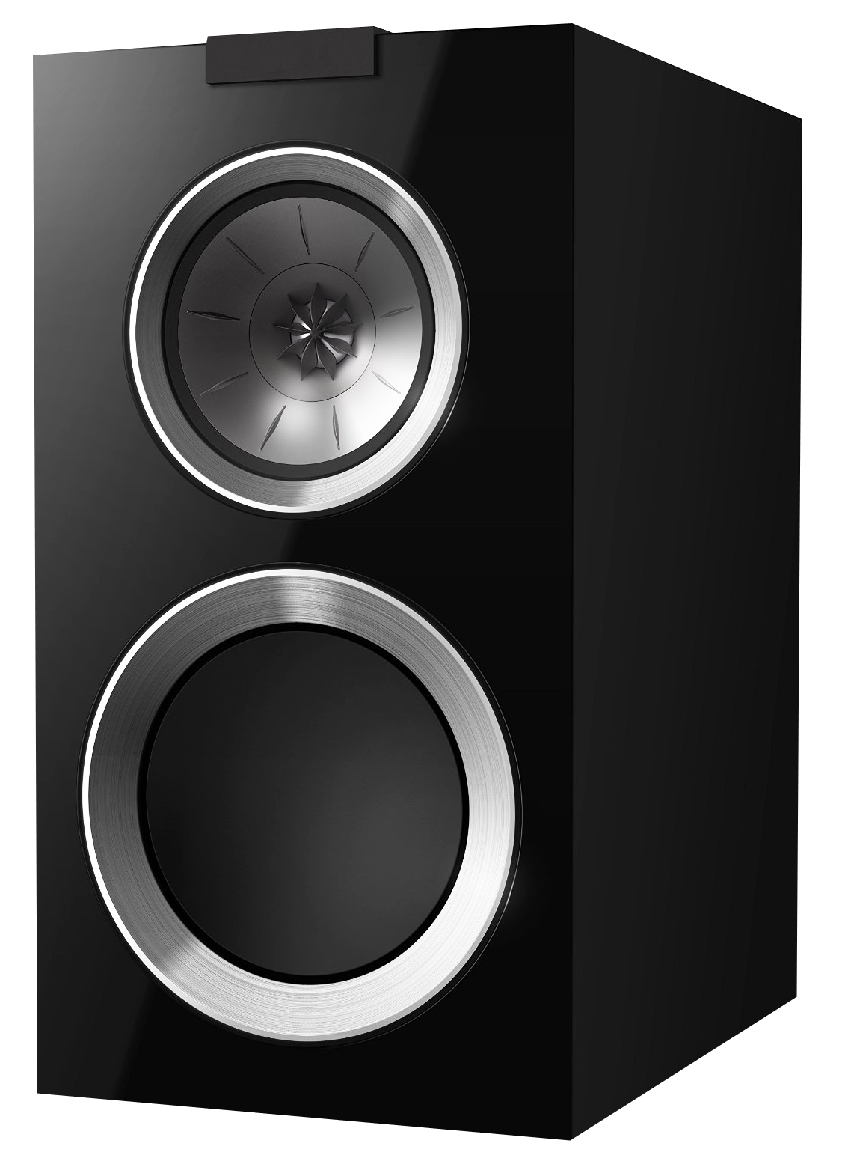
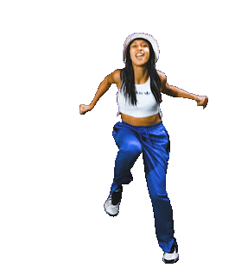
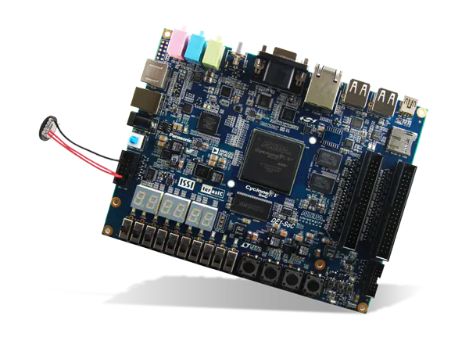

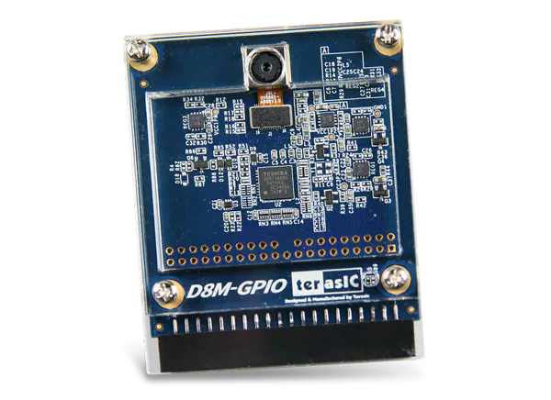

External Connections Diagram
Song Output
Audio Data
Linux CLI
User Dance
Camera Data
MP4 File
Reference Video Data
Reference Video
Notes:
Reach out to Shantanu if there any concerns with this slide

Slide 5
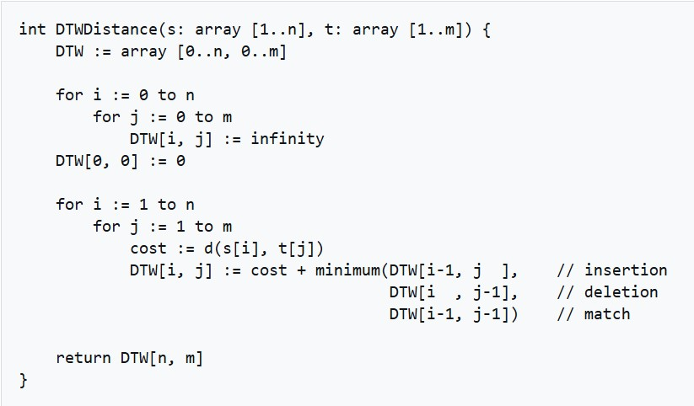
Algorithms to Accelerate
Dynamic Time Warping (DTW)
Measures similarity between two temporal sequences of different speeds.
Can be used to assess similarity between reference video and live dance!
Problems
Large Bellman matrix
High computation time
Solutions
Shifting window (Sakoe-Chiba)
Efficient cost calculation

Slide 6
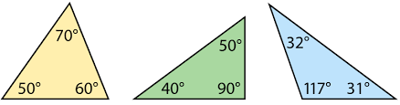
Algorithms to Accelerate
Atan2() Approximation
Calculate the angles of the triangle shaped by the hands and waist.
Problems
Multiplication/Division/Square Root operations
High computation time
Solutions
Cordic Rotation Algorithm
Only use shift and additions

Slide 7
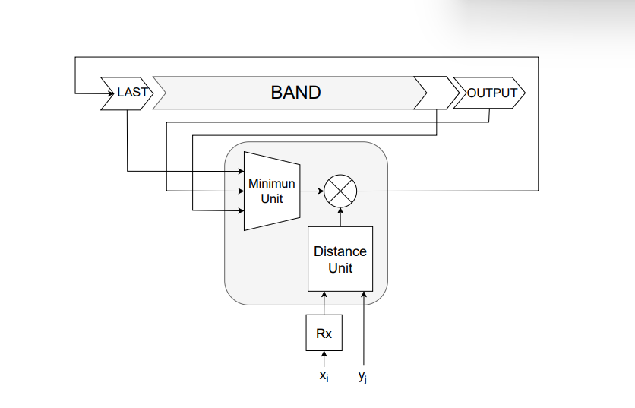
Accelerator Implementation
score
Communication Method:
The game loop communicates with the accelerator via a custom bus
Workflow:
Task Offloading: The game loop sends the input data streams to the accelerator through the custom bus one frame at a time
Processing: The accelerator compares the similarity of the two data streams using an optimized DTW algorithm
It only maintains one row of the cost matrix at a time to minimize memory usage
Completion Signal: The game loop tells the accelerator that the video is done and the accelerator outputs a similarity score
Reference:
M. Hormigo-Jiménez and J. Hormigo, “High-Throughput DTW accelerator with minimum area in AMD FPGA by HLS,” Repositorio Institucional de la Universidad de Málaga, pp. 1–6, Nov. 2023, DOI: 10.1109/dcis58620.2023.10335963.
Done

Slide 8
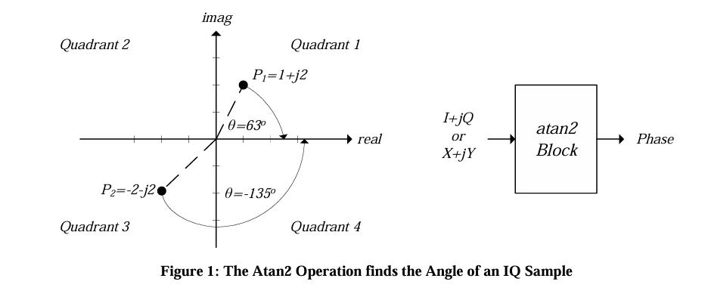
Accelerator Implementation
score
Communication Method:
Ready signal and dedicated registers.
Workflow:
Task Offloading: The game loop sends the input data streams to the accelerator through the custom bus one frame at a time
Processing:
1. LUT-determined arctan(2^-i)
2. Iterative Rotations (Parameter)
3. Store the final angle and set the ready signal high
Completion Signal: The atan2 block sets a ready signal high for the angle to be read by the game loop.
Reference:
F. De Dinechin and M. Istoan, "Hardware Implementations of Fixed-Point Atan2," 2015 IEEE 22nd Symposium on Computer Arithmetic, Lyon, France, 2015, pp. 34-41, doi: 10.1109/ARITH.2015.23.
Done

Slide 9
Verification of Original Plan
What has remained the same?
Core game functionality
Image processing & motion tracking
Accelerator purpose
What has changed?
Tracking specific points vs entire body
No processor enhancements
Why?
Still implementing just dance!
Need a scoring mechanism
Scoring needs to happen quickly
Why?
Tracking the entire body is hard
Tracking multiple points is still hard, but simpler
If it ain’t broke, don’t fix it

